Slide 1
Visualization of operations on Tree Data structures
Group 9

Slide 2
Problems
Difficulty understanding abstract concepts
Challenges in identifying errors
Challenges in explaining concepts to others
Difficulty building & debugging code

Slide 3
Benefits of Visualization
Make it easier to follow the logic and internal movements within the structure.
A
B
Allow to inspect the state of the tree at each step.
A
B
C
F
Help to communicate complex concepts in a clear and concise way.
D
E
Help to reveal errors in the implementation of tree operations.
C
E
G
K
H
I
Help to develop intuition about how tree data structures work.
It is easier to pinpoint the root cause of errors.
D
F

Slide 4
Types of tree data structures
3
2
Balanced tree
Generic tree
A tree is a nonlinear hierarchical data structure that consists of nodes connected by edges and contains no cycles.
A balanced tree is a tree where each leaf node is "not more than a certain distance" away from the root than any other leaf.
1
4
Binary tree
Balanced binary tree
A binary tree is a tree where each node has at most two children.
2
3
A balanced binary tree has the properties of both a binary tree and a balanced tree.
4
1

Slide 5
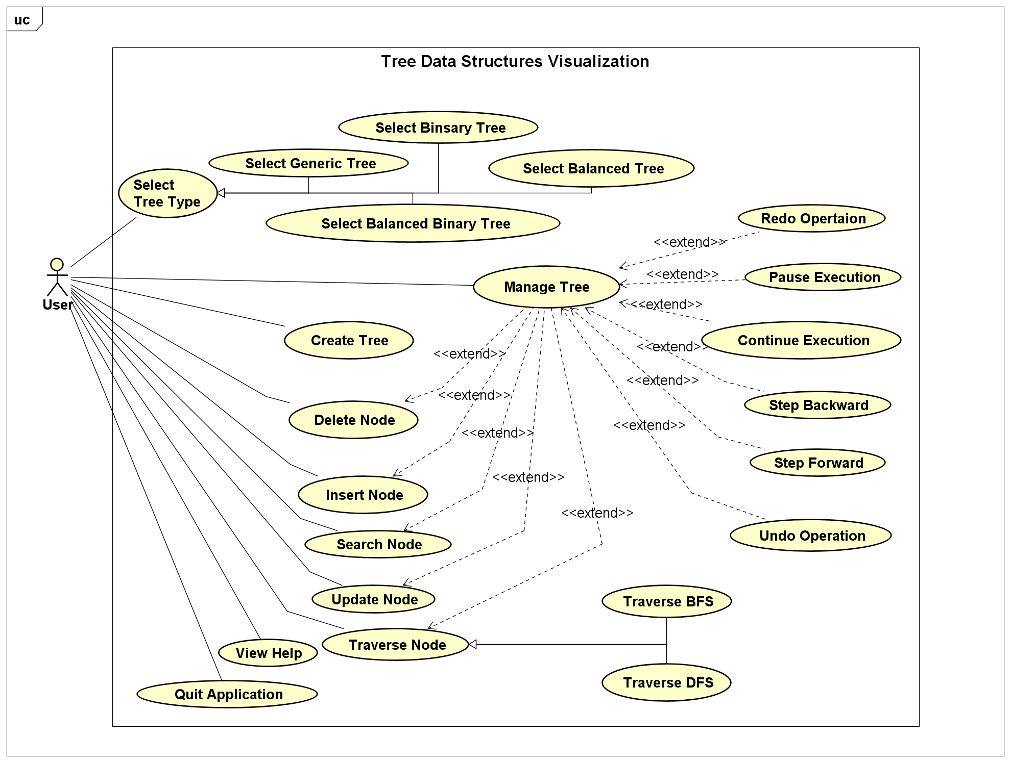
Use Case Diagram

Slide 6
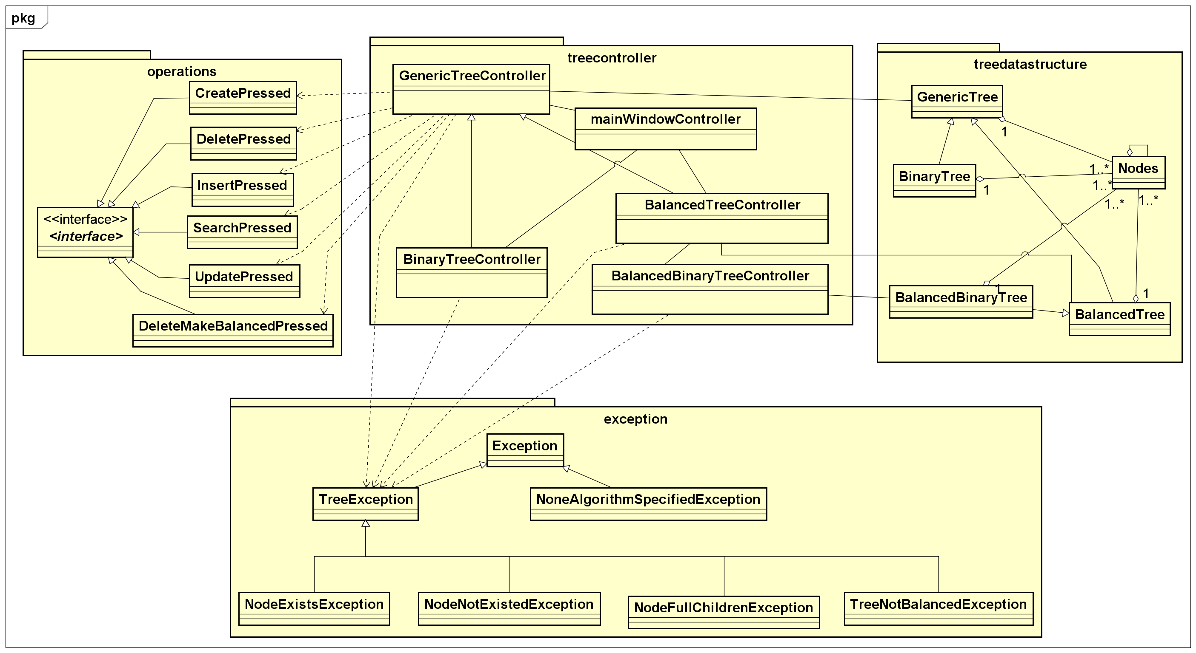
General Class Diagram

Slide 7
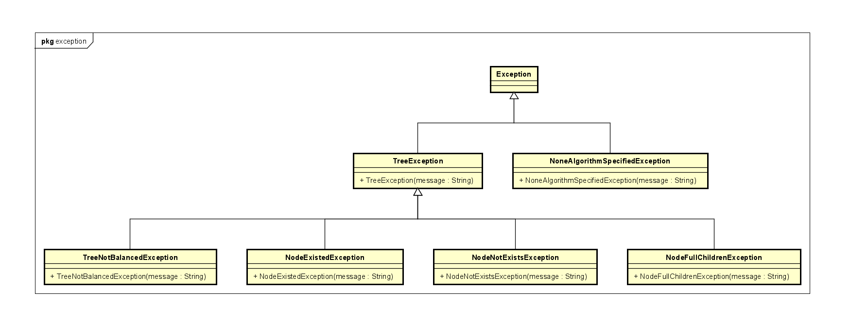
Exception Class Diagram

Slide 8
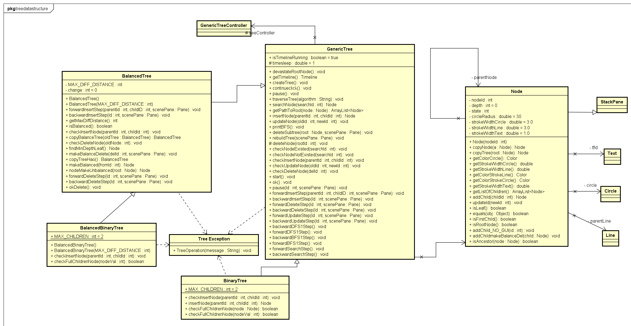
Tree Data Structure Class Diagram

Slide 9
Tree Data Structure Class Diagram
Generic Tree class
A generic tree is a tree structure where each node can have an arbitrary number of children nodes.
Six operations are supported in the Generic Tree Class, including insert, delete, search, traverse, create, update
For each operation, corresponding exceptions are handled, ensuring robustness in the tree's manipulation.
The class also implements checking algorithms to validate the operations, ensuring the tree remains consistent.

Slide 10
Tree Data Structure Class Diagram
Binary Tree Class
The Binary Tree Class is a subclass of the Generic Tree Class with modifications to handle binary trees.
The insert operation is enhanced to check if a node can accept more children or raise NodeFullChildrenException.
Other operations are inherited from the Generic Tree Class, ensuring a unified interface for tree manipulation.

Slide 11
Tree Data Structure Class Diagram
Balanced Tree Class
The Balanced Tree Class represents a balanced tree data structure that maintains depth difference among leaf nodes, ensuring efficiency.
It inherits from the Generic Tree Class and adds two algorithms for insert and delete operations to maintain balance.
If an invalid operation makes the tree unbalanced, the user can choose to undo or proceed with the operation.
When proceeding, our algorithms re-balance the tree, which may involve changing some nodes' parent nodes.

Slide 12
Tree Data Structure Class Diagram
Balanced Binary Tree Class
The Balanced Binary Tree Class is a subclass of the Balanced Tree Class, tailored for binary trees.
It introduces additional methods and logic to maintain the binary property during insertions.
The class ensures that the binary tree remains balanced and efficient while supporting all generic tree and balanced tree operations.

Slide 13
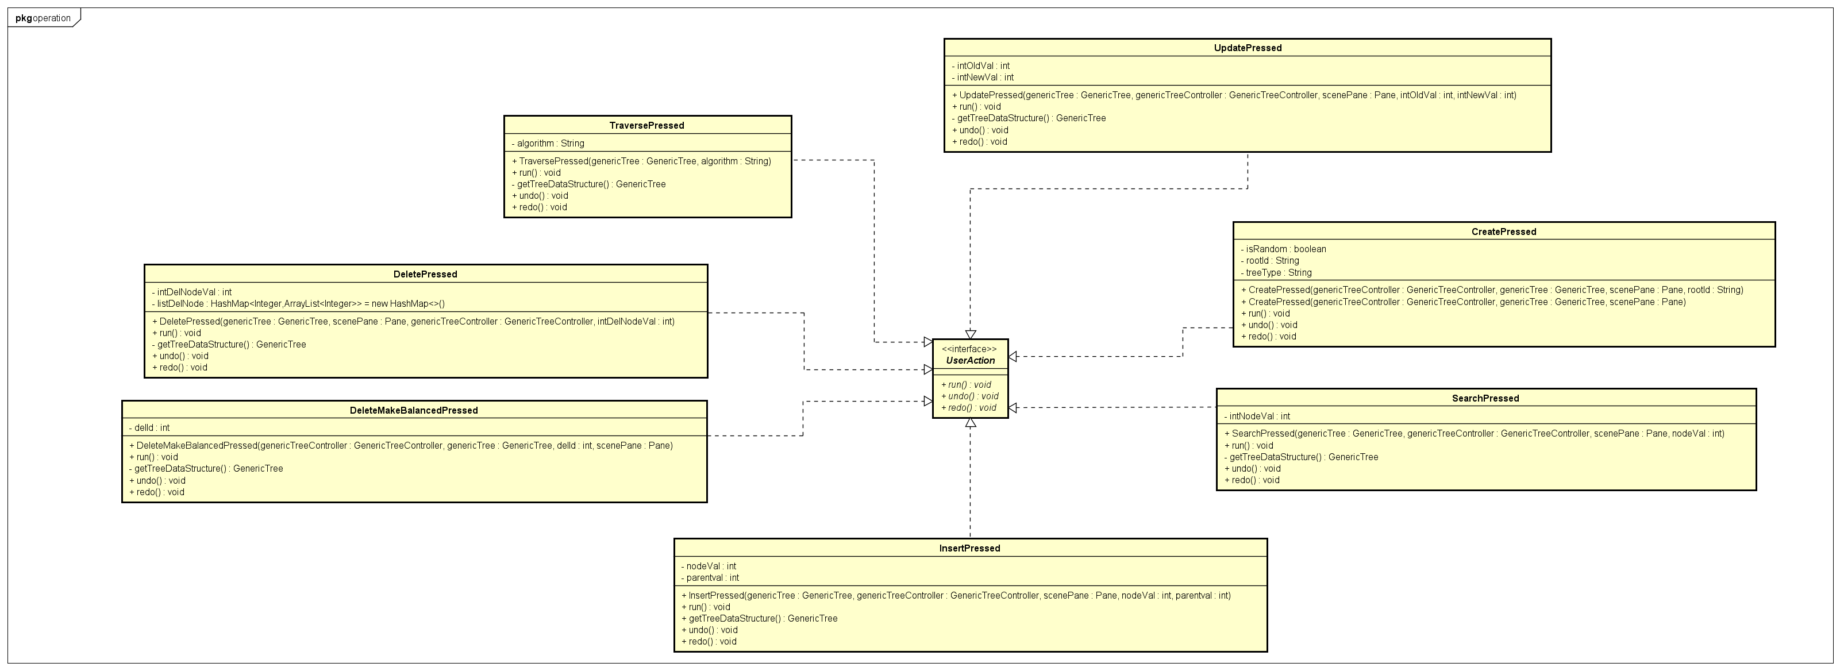
Operation Class Diagram

Slide 14
Explaination of OOP techniques

Slide 15
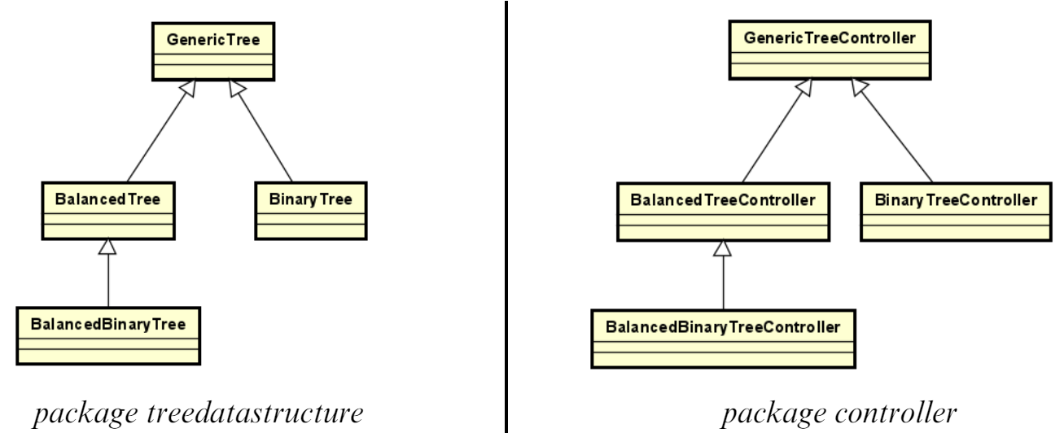
Inheritance

Slide 16
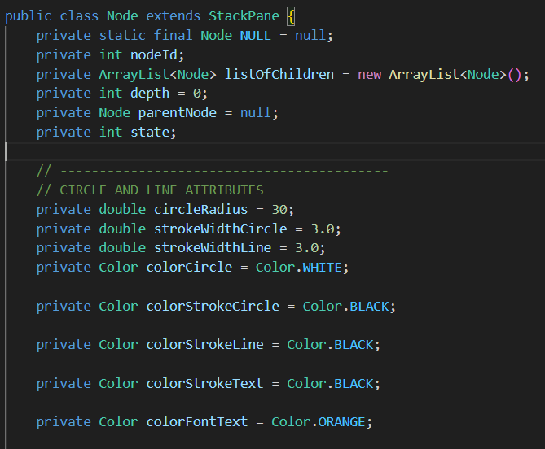
Encapsulation
We’ve used the Encapsulation technique in almost all classes to hide the internal state and implementation details from external entities
1
For example, in class Node, we set ‘private’ for its attributes such as NodeId, depth, …
2
3
If other classes want to access the attributes, they can use getter and setter methods.

Slide 17
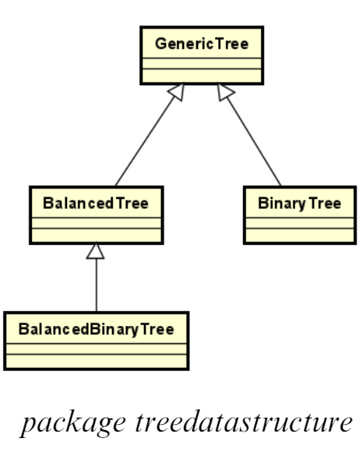
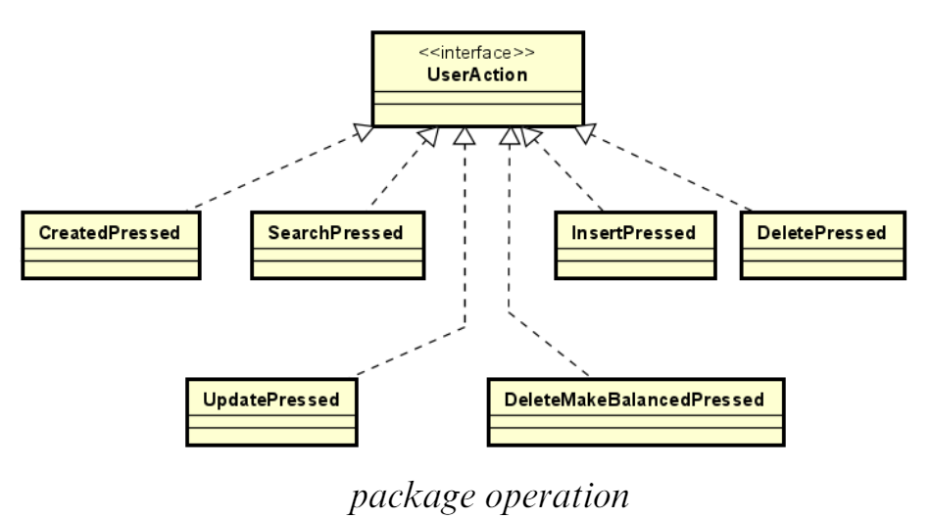
Polymorphism
Implementing an “undo” and “redo” operation.
Implementing each operation.

Slide 18
Association & Aggregation
The Node has its parent which is also a Node and when the Node is deleted, its parent still exists.
GenericTreeController controls and manipulates the GenericTree.
In addition, this relationship is presented where the GenericTree has a root Node.
The operation classes in package operation change the GenericTree and manipulate the tree-display Pane of GenericTreeController.

Slide 19
Composition
The Node contains three objects Circle, TextField, Line which are used to display the node on screen.
The Node has many children (which are stored in an attribute arraylist listOfChildren).
GenericTreeController has an array named history which contains many UserActionimplemented objects.

Slide 20
Dependency
1
The controller classes depend on the tree data structure classes.
The main application class depends on the ‘controller’ package.
2
3
4
The GenericTreeController class depends on the operation classes in package operation to
perform the corresponding tree operations.
In the operations of four types of tree, we also use the Exceptions, so the Trees are dependent on the Exceptions.

Slide 21
Conclusion
Effective visualizations can improve learning, debugging, communication, and intuition
Visualization is a powerful tool for enhancing understanding and working with tree data structures
Visualization tools and techniques are readily available and easy to use

Slide 22
Thanks for listening

